Slide 1
Memory management.

Slide 2
Virtual Memory
With 64 bits, processes can address up to 2⁶⁴ memory addresses (=Exabytes!)
Most computers don’t exceed 4 GB = 2³² B of physical memory (RAM)
Furthermore, this memory is shared between OS and multiple processes
➔ need for « virtual memory » vs. « physical memory »

Slide 3
Page table and DAT
The most used pages are kept in cache and RAM, others are on slower devices (mainly disks)
➔ need of a « page table »
+ a translation mechanism to locate where a « virtual address » is « physically » stored
➔ translation done by the MMU, and called « Dynamic Address Translation » (DAT)
Notes:
MMU = Memory Management Unit

Slide 4
Two-level hierarchical page table

Slide 5
Page table location
Physical memory
Easy to address, no translation required
But consumes memory
Virtual memory (OS virtual address space)
Unused page table pages can be paged out to disk
But, addressing page tables requires translation!
➔ In cache and RAM

Slide 6
Virtual memory
Main memory
Page | Table
9 | 0
3 | 1
107 | 2
89 | 3
… | …
191 | 30
Free | 31
4 | 32
5 | 33
7 | 34
131 | 35
…
Free | 219
Free | 220
0 | 221
67 | 222
132 | 223
Secondary memory

Slide 7
Basic hardware techniques for DAT.
Direct mapping:
real page addresses stored in a high speed random access memory.
Associative mapping:
virtual and real addresses are stored, simultaneous compare performed.
Set-associative mapping:
combination of direct and associative.

Slide 8
Direct mapped cache - Example
Block 0
Block 1
Block 2
…
…
…
…
…
…
…
…
…
…
…
…
…
Block 2²⁰-1
Block 0
Block 1
Block 2
…
Block C-1
CPU of 32 bits
Block size 4K = 2¹² bytes
Cache 512K = 2¹⁹ bytes = 2⁷ blocks (C=128)
Cache
Block C
Block C+1
Block C+2
…
Block 2C-1
Block 0
Block 1
Block 2
…
Block C-1
…
Possible conflicts
Possible underuse of cache
Block
Block
Block
…
Block 2²⁰-1

Slide 9
Direct mapped cache - Example
Block 0
Block 1
Block 2
…
Block C-1
Tag correspondence
indicates
cache hit
or miss
(+valid/
dirty bit)
Cache
Block C
Block C+1
Block C+2
…
Block 2C-1
B
0
1
1
Tag
Tag
Tag
…
Tag
Block 0
Block 1
Block 2
…
Block C-1
… (*2¹³)
32 bits address
Block 2²⁰-C
Block
Block
…
Block 2²⁰-1
 | < Cache size > | < Block size >
Tag (13 bits) | Cache index (7) | Offset (12 bits)

Slide 10
Associative mapping
Block 0
Block 1
Block 2
…
Block C-1
Tag correspondence
indicates
cache hit
or miss
Cache
Block C
Block C+1
Block C+2
…
Block 2C-1
B
0
1
1
Tag
Tag
Tag
…
Tag
Block 0
Block 1
Block 2
…
Block C-1
… (*2¹³)
32 bits address
Block
Block
Block
…
Block 2²⁰-1
 | < Block size >
Tag (20 bits) | Offset (12 bits)

Slide 11
Basic hardware techniques for DAT.
Direct mapping:
Very efficient for search (direct access)
Limited hit ratio
Associative mapping:
Slow search: scan/“walk-through”, or parallel search in Content Addressable Memory (CAM)
Optimised hit ratio
➔ Set-associative mapping:
combination of direct and associative.

Slide 12
Set (N-way) Associative mapping
Block 0
Block 1
Block 2
…
Block S-1
B
1
Tag
…
Tag
Block 0
…
Block W-1
Set 0
Block S
Block S+1
Block S+2
…
Block 2S-1
Split the
cache into “sets”, e.g.
16 Sets of
8 entries = Ways
B
1
Tag
…
Tag
Block W
…
Block 2W-1
Set 1
…
…
…
Block
…
Block S*W-1
…
B
1
Tag
…
Tag
Set S-1
Block
Block
Block
…
Block 2²⁰-1
 | < Cache size > | < Block size >
Tag (16 bits) | Set index (4) | Offset (12 bits)

Slide 13
Translation Lookaside Buffer (TLB)
Each virtual memory reference can cause two or more physical memory accesses
one (or more) to lookup the (2-level) page table
one to fetch the data
A high-speed on-chip cache is set up for page table entries
called a Translation Lookaside Buffer (TLB)
managed by Memory Management Unit (MMU)

Slide 14
Translation Lookaside Buffer (TLB)
Page n
Offset
TLB
Miss
Load
TLB
Main memory
page table
OR
Hit
Frame k
Offset

Slide 15
Translation Lookaside Buffer (TLB)
Contains most recently used page table entries
Processor examines the TLB for the given virtual address
If page table entry is found (TLB hit), the frame number is retrieved and the real address is formed

Slide 16
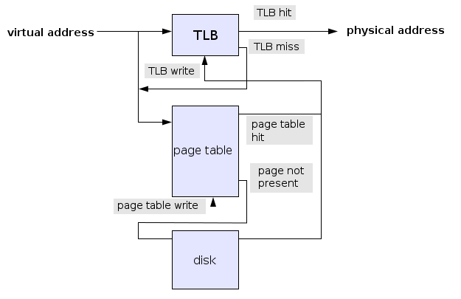
Translation Lookaside Buffer (TLB)
If page table entry is not found (TLB miss), the search is done in the process page table
First checks if page is already in main memory
If not in main memory → page fault
The TLB is updated to include the new page entry

Slide 17
TLB.
TLB are mainly based on the set-associative mapping technique
set size is 1 (=fully associative) or 2 to 4
Relatively small
32-64 (TLB L1) to 512 (TLB L2) entries
processes only use a small number of pages at a time,
only those pages need to be “mapped”,
so high hit ratio can be achieved with a small index

Slide 18
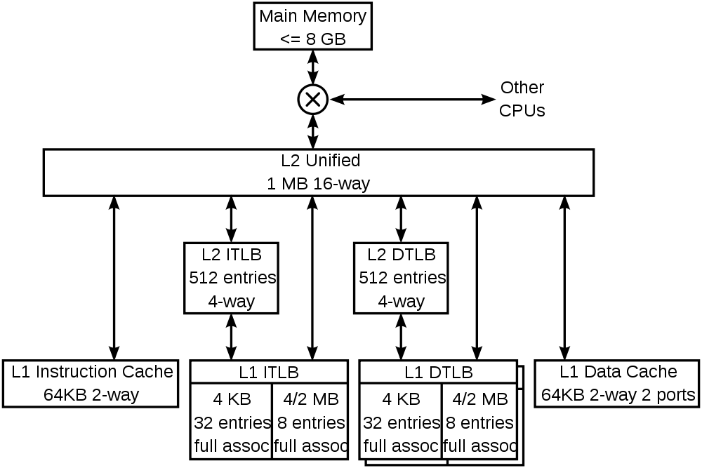
TLB and multi-level caching.
The K8 core in the
AMD Athlon 64 CPU.

Slide 19
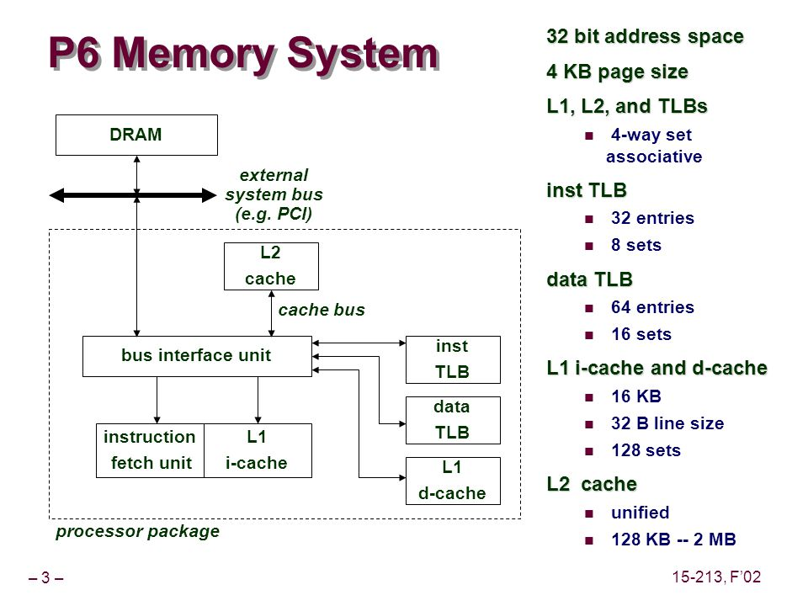
TLB and caches
The IBM P6
processor

Slide 20
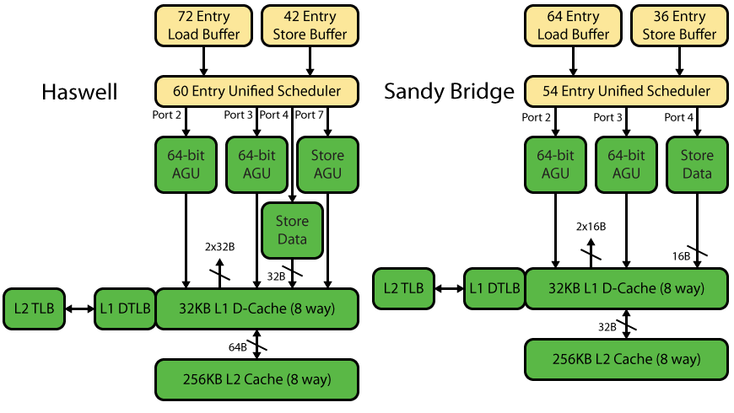
Intel cases
Sandy Bridge = Celeron/Pentium/i3/i5/i7/Xeon … 2011 - 2013
Intel Haswell = i3/i5/i7/Xeon … since 2013
Notes:
AGU = Address Generation Unit

Slide 21
Paging policy.
Paging policy defines how pages are loaded and unloaded by the virtual memory system.
Fetch policy: when a page should be loaded in primary memory
Replacement policy: which pages should be removed from primary memory if all page frames are full
Placement policy: where the fetched page should be loaded in main memory

Slide 22
Some basic terms
Page reference stream:
sequence of page numbers referenced by a process during its execution
Virtual time:
the index of the page in the reference stream
Backward distance:
for a page “r” at time “t”: distance in the reference stream from r to the last occurrence of the page in the preceding part of the reference stream (0 to ∞)

Slide 23
Fetch policy.
Demand paging (standard approach)
page reference stream not known in advance
which page to load is discovered during run-time, so load “on demand” when a page fault occurs
Anticipatory paging
after reading a page to service a page fault, read the next few pages even though they are not yet needed (a prediction using locality of reference, efficient for sequential read or “block reads”)
Limited efficiency, best to concentrate on replacement policies

Slide 24
Page replacement policies.
Static:
Random
First-in, first out (FIFO)
Clock based
Least recently used
Least frequently used
Dynamic:
Working set

Slide 25
Random.
Replaced “victim” page is chosen at random.
No knowledge of the (past) reference stream is used
Causes more miss than other algorithms
Quickly abandoned by systems designers in the early 60’s.

Slide 26
First In-First out (FIFO).
Page entries
Pointer
At page fault time,
page replaced and
pointer incremented
Typically: a fixed size list
Notes:
= « Least recently stored » - oldest page is the victim

Slide 27
Clock based = Not recently used (NRU).
Same principle as FIFO: pointer incremented but page skipped if recently referenced
Page entries
Pointer
1
1
1
0
At page fault time:
“1” bit reset to “0”, & entry skipped
“0” bit entry replaced and set to “1”
pointer incremented
1
0
1
0
1
Hit
1
0
1

Slide 28
Least recently used (LRU).
Designed to take advantage of normal program behaviour:
spatial and temporal locality of reference
a referenced page is likely to be referenced soon
Requires to maintain an access chronogram
timestamp per page, updated at each reference
or a backward distance (stack implementation)

Slide 29
Least (or Not) frequently used (LFU/NFU)
Approximation based on periodic scan and reset of reference bit maintained by the hardware
Page replaced if was not used often in the past.
Reacts slowly to change in locality:
if set of pages changes, page in the new locality will have a use count lower than the older one.
➔ some aging mechanism required

Slide 30
Working set algorithm.
Uses current memory requirements (pages referenced in the past “T” interval) to determine the number of frames to allocate to the process.
A page is unloaded if it was not referenced in the past “T” interval
Intuitively, the working set corresponds to the set of pages in a process locality.

Slide 31
Working set algorithm.
w(T,t)
Pages in
working set
Pages
Process A
Process B
Process C
Process D
End or sleep or wait …
Process E
t
Window
Virtual processing Time
← T →

Slide 32
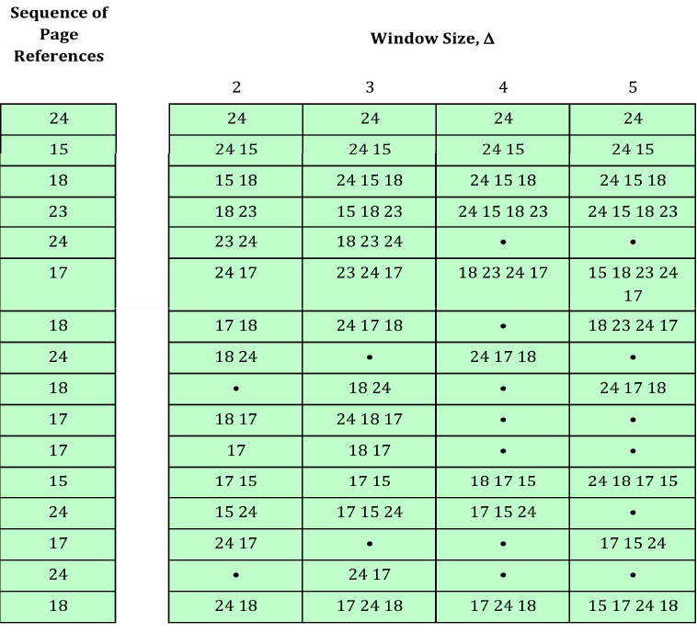
Working Set
Evolution of the Working set, depending on the Window Size

Slide 33
Belady’s optimal algorithm (OPT).
Perfect knowledge of the page reference stream = anticipate the future!
Always results in least possible page faults
Replace the page with maximal forward distance (the latest from now on)
Not realis able, theoretical behaviour is used to compare the performance of a realisable algorithm

Slide 34
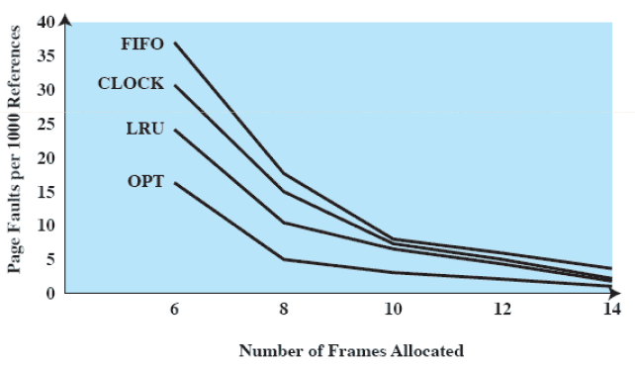
Algorithms efficiency

Slide 35
Stack algorithm.
Inclusion property:
set of pages loaded with a memory allocation of m frames is always a subset of the set of pages loaded with a memory allocation of m+1 frames.
Algorithms that satisfy the inclusion property are:
not subject to Belady’s anomaly
called “Stack algorithms”

Slide 36
Belady’s anomaly.
0
1
2
3
0
1
4
0
1
2
3
4
0
1
2
3
0
1
4
4
4
2
3
3
0
1
2
3
0
1
1
1
4
2
2
0
1
2
3
0
0
0
1
4
4
0
1
2
3
3
3
0
1
1
2
2
2
3
0
0
P
P
P
P
P
P
P
P
P

Slide 37
Belady’s anomaly
0
1
2
3
0
1
4
0
1
2
3
4
0
1
2
3
3
3
4
0
1
2
3
4
0
1
2
2
2
3
4
0
1
2
3
0
1
1
1
2
3
4
0
1
4
0
0
0
1
2
3
4
0
1
0
1
2
3
4
0
P
P
P
P
P
P
P
P
P
P

Slide 38
Distance string.
0
2
1 3 5 4 6 3 7 4 7 3 3 5 5 3 1 1 1 7 1 3 4 1
0
2
1
3
5
4
6
3
7
4
7
3
3
5
5
3
1
1
1
7
1
3
4
1
0
2
1
3
5
4
6
3
7
4
7
7
3
3
5
3
3
3
1
7
1
3
4
0
2
1
3
5
4
6
3
3
4
4
7
7
7
5
5
5
3
3
7
1
3
0
2
1
3
5
4
6
6
6
6
4
4
4
7
7
7
5
5
5
7
7
0
2
1
1
5
5
5
5
5
6
6
6
4
4
4
4
4
4
5
5
0
2
2
1
1
1
1
1
1
1
1
6
6
6
6
6
6
6
6
0
0
2
2
2
2
2
2
2
2
2
2
2
2
2
2
2
2
0
0
0
0
0
0
0
0
0
0
0
0
0
0
0
0
P P P P P P P P P P P
∞ ∞ ∞ ∞ ∞ ∞ ∞ 4 ∞ 4 2 3 1 5 1 2 6 1 1 4 2 3 5 3
Notes:
« LRU »

Slide 39
Page fault estimation.
∞ ∞ ∞ ∞ ∞ ∞ ∞ 4 ∞ 4 2 3 1 5 1 2 6 1 1 4 2 3 5 3
C1 = 4
F1 = 20
C2+C3+…C∞
C2 = 3
F2 = 17
C3 = 3
F3 = 14
C4 = 3
F4 = 11
C5 = 2
F5 = 9
C6 = 1
F6 = 8
C7 = 0
F7 = 8
C∞ = 8
F∞ = 8

Slide 40
Paging algorithm efficiency.
P(d)
P(d)
<-k->
<---k--->
d
d

Slide 41
Segmentation.
Allows the programmer to view memory as consisting of multiple address spaces or segments of different size
Some segments can be shared between processes
Each segment table entry contains the starting address of the corresponding segment in main memory and the length of the segment

Slide 42
Segmentation.
Generated addresses are made of 2 components:
Segment number or identifier
Offset
Segment number is a base location
Offset is the offset of the target cell in the segment.
Segmentation and paging can be combined

Slide 43
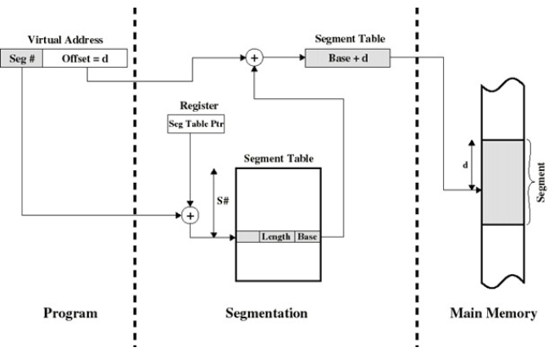
Segmentation

Slide 44
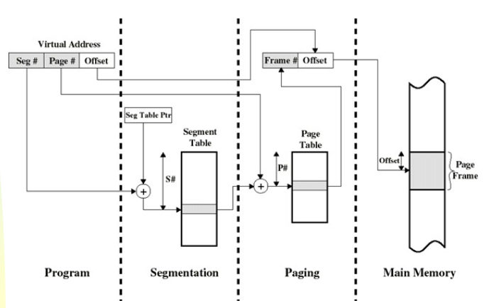
Segmentation and paging
Notes:
Source des graphiques:
http://slideplayer.com/slide/4259301/

Slide 45
MVS segmentation.
Address
space A
Code
Data
Space B
Data
Data
Space C
Data
Instruction is
executed on
dataspace data
Fetch instruction from
Address space A
Translate data addresses
using page table addressed
by access register

